Slide 1
PYTHON PROJECT
Sentiment Analysis
GROUP MEMBERS :
SHASHWAT SINGH (2017KUCP1054)
PRASHRYA RAO (2017KUCP1057)
AYUSH KUMAR SINGH (2017KUCP1053)
MENTORED BY :
Mr. Mayank Jain Sir
IIIT Kota

Slide 2
Objective/AIM
This project aims at developing an extremely useful social media monitoring tool which can be accessed via GUI(Graphical User Interface) as well as through command-line interface.

Slide 3
Applications
Sentiment Analysis is the process of ‘computationally’ determining whether a piece of writing is positive, negative or neutral. It’s also known as opinion mining, deriving the opinion or attitude of a speaker. The applications of sentiment analysis are broad and powerful. The ability to extract insights from social data is a practice that is being widely adopted by organisations across the world. It can also be an essential part of one’s market research and customer service approach. Not only one can see what people think of his/her products or services, one can also see what they think about their competitors too. The overall customer experience of one’s users can be revealed quickly with sentiment analysis. In political field, it is used to keep track of political view, to detect consistency and inconsistency between statements and actions at the government level. It can be used to predict election results as well.

Slide 4
Technologies Used
Frontend:
Flask (a micro web framework written in Python)
HTML5
CSS3
Bootstrap
Backend:
Python3
Database:
Sqlite3
Session Management:
Flask Session (extension for Flask that adds support for Server-side Session)

Slide 5
Libraries Used
Flask
Nltk
Plotly
Termcolor
Twython
Colorama
Flask_session
Passlib
Cs50

Slide 6
TABLES SCHEMA
Histories
histories(id integer, screenname text, positive float, negative float, neutral float, transacted datetime default CURRENT_TIMESTAMP, flag text)
Users
users(id integer primary key AUTOINCREMENT not null, username text not null, hash text not null)

Slide 7
Functions Used
search()
login()
logout()
register()
passwordchange()
history()
index()
emojis()

Slide 8
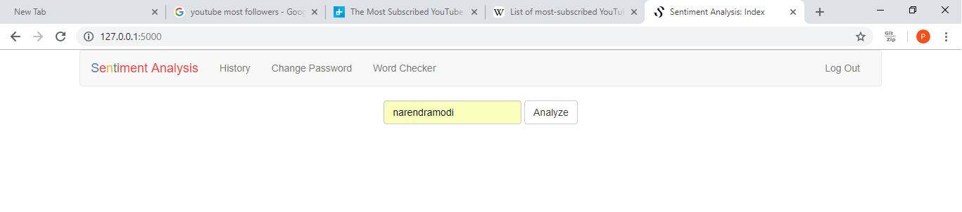
Our Main Page

Slide 9
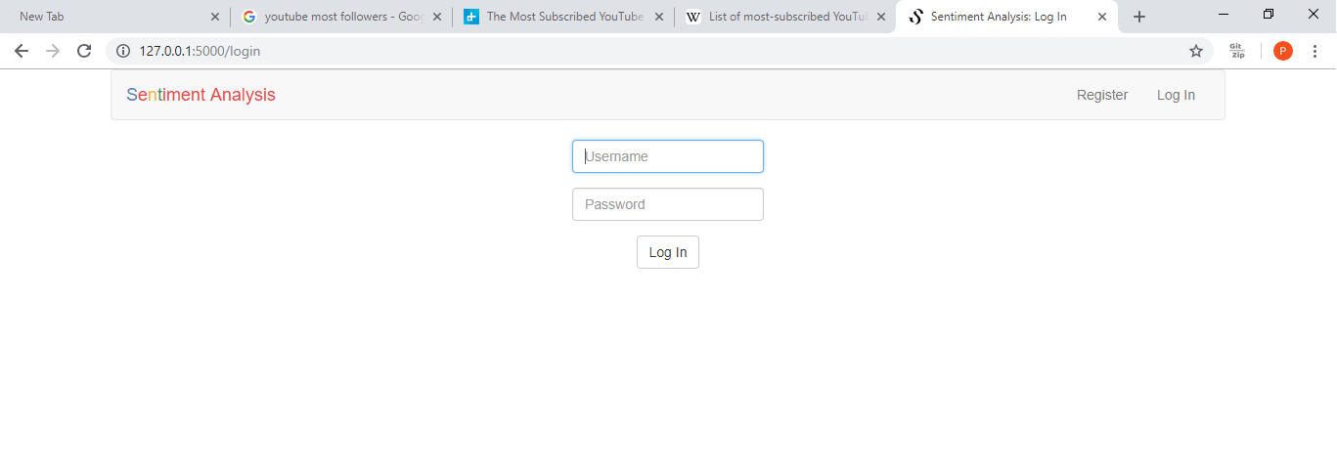
Our Login Page

Slide 10
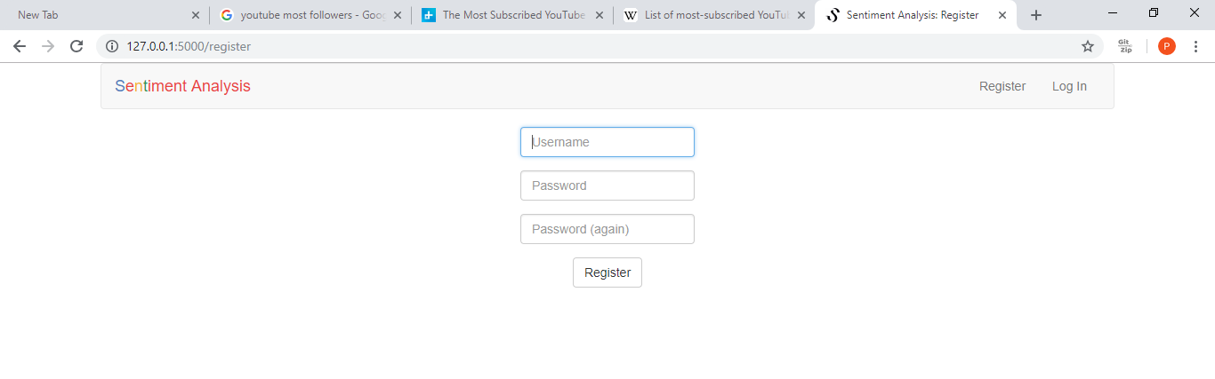
New User Register Page

Slide 11
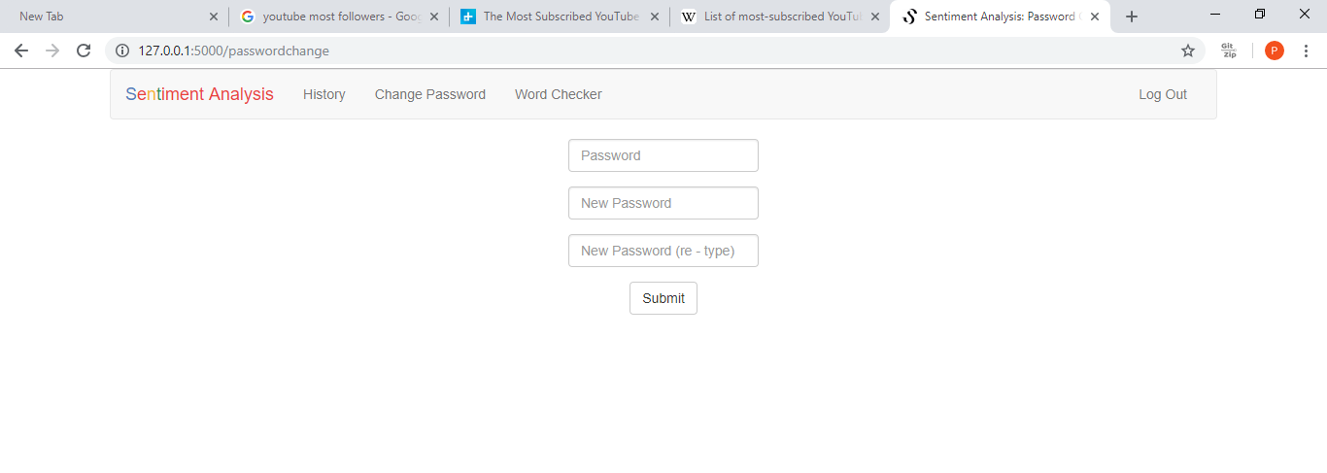
Password Reset

Slide 12
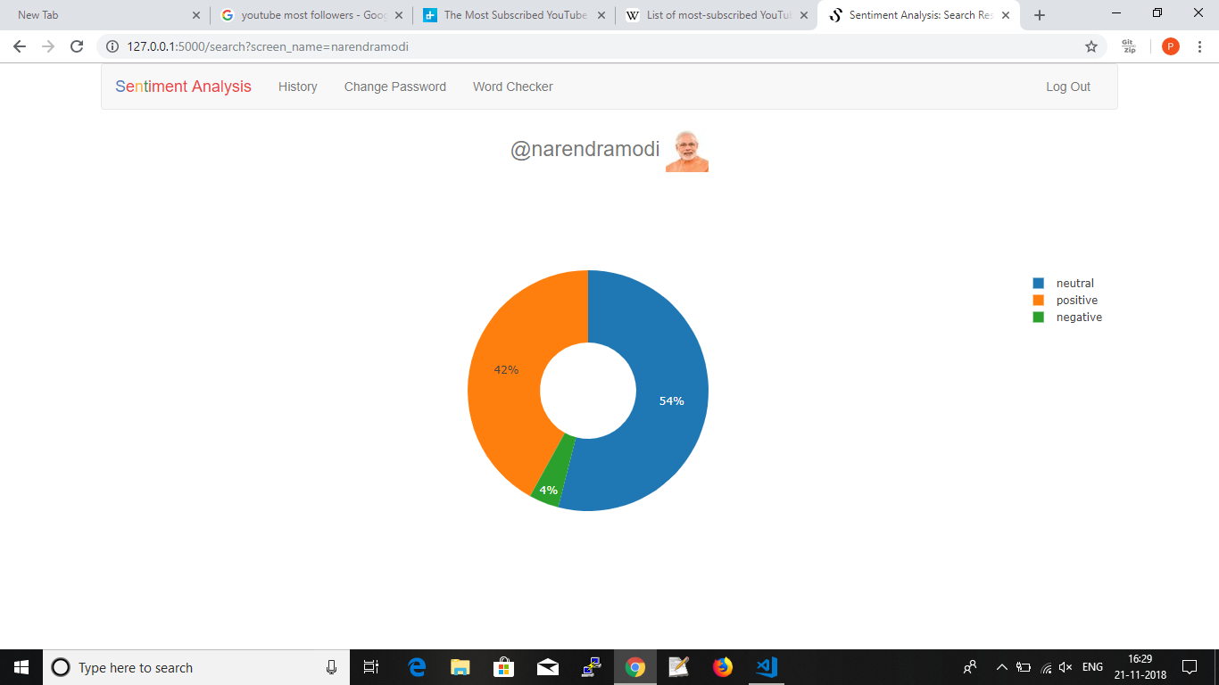
User Analysis

Slide 13
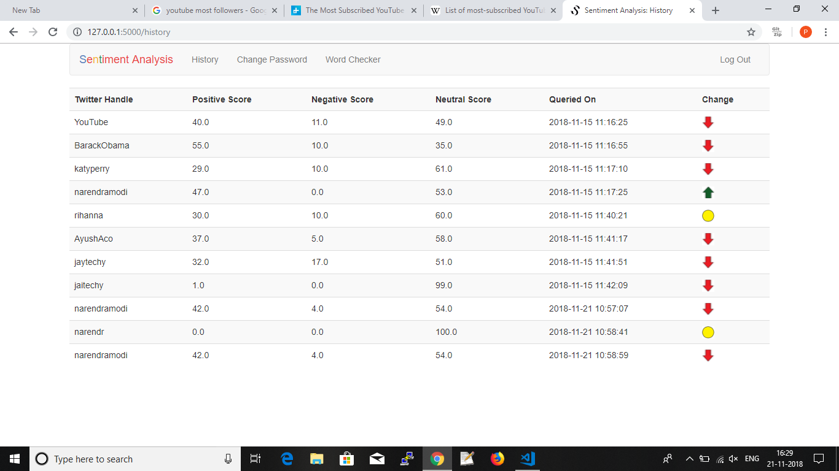
Search History Page

Slide 14
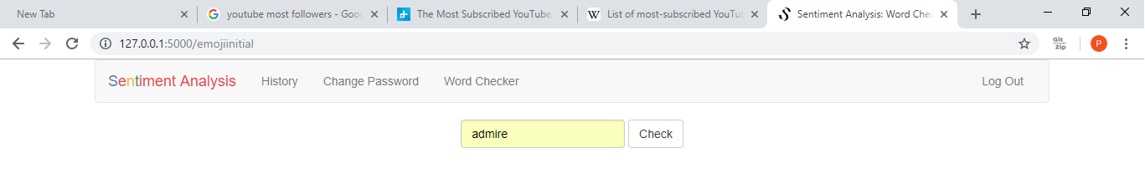
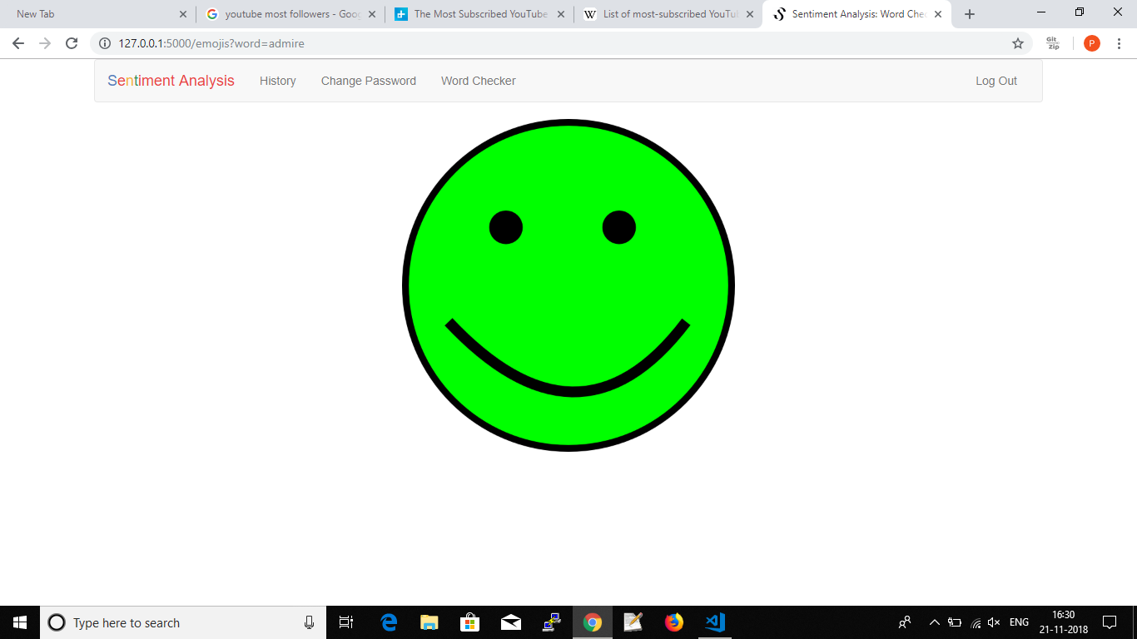

Slide 15
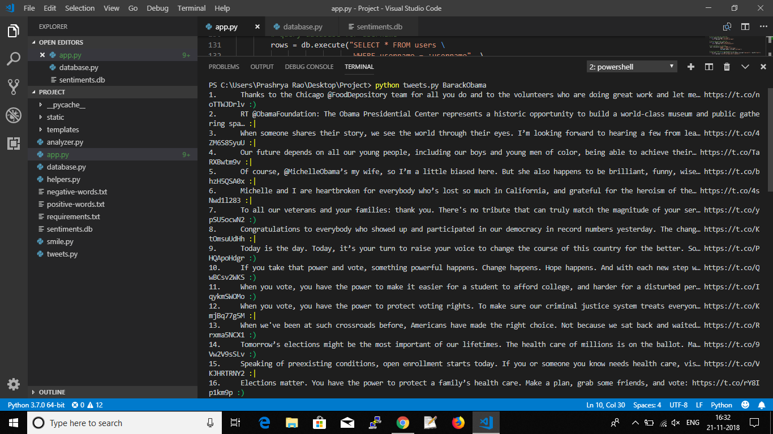

Slide 16
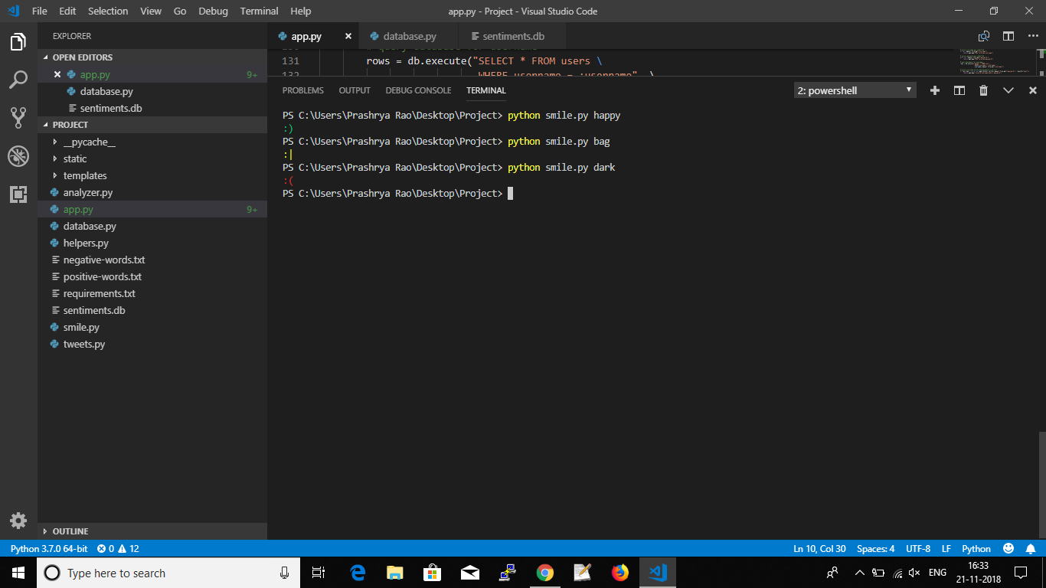

Slide 17
Thank You!!

